Slide 1

MPCS 56430 Project:
Chess Database Analysis
Shane McVeigh

Slide 2

Introduction / Background
Lichess is one of the most popular open-source online chess websites
They offer free access to their very large game database files per month (~30 GB per month)
It can take a very long time to parse through this data, so effective parallelization and HPC concepts are key
I sought to answer the following questions:
  What openings are popular at different ratings?
  Are openings/time controls gaining or losing popularity?
  Does playing with white/black matter more at different skill levels?
  What is the average rating difference for the winner?

Slide 3
Methodology
Lichess files are stored in a standard format which supports decompression and streaming using the python Zstandard library
Performance-improving methods:
  Using TextIOWrapper with a buffer to more effectively stream data
  Multiprocessing library in Python, with pools, to improve parallelism
  Use Zstandard decompressor to avoid saving 30 GB files and up to 2 TB of data analyzed
Pools improved parallelism (about 2x improvement), but overhead with IOWrapper and network speeds was the limiting factor
  This cannot be overcome without downloading the data (not feasible)

Slide 4
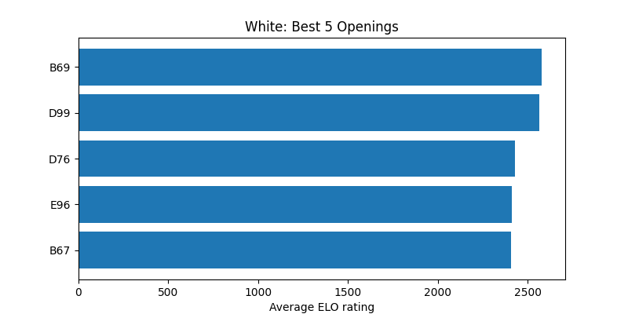
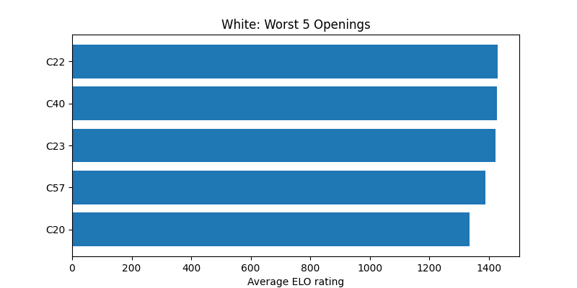
Highest and Lowest Openings by Average Rating
Openings differed by up to 1100 points in average ELO rating, a significant gap
Queen-pawn openings were generally the highest rated, while king-pawn openings occurred in lower rated games
Best response to e4 is the Sicilian, and play d4 as the white pieces

Slide 5
Long-Term Trends
Time Controls:
  Bullet is < 2 min per side
  Blitz 2-5 min
  Rapid > 5 min
Bullet has gained a larger share of the games played over time
Following a global trend of lower attention spans?
Openings come and go in terms of popularity
  This has existed for < 1,000 years

Slide 6
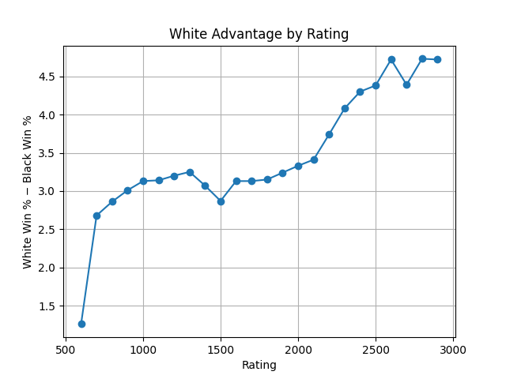
Win-Rate Statistics
Average ELO difference between winning and losing side across 94M games was 19.51
  This lends credence to the effectiveness of ELO as a rating metric
  A randomized metric would move towards 0 ELO difference
White-piece advantage started around 2.8% at lower rating levels and increased up to 4.5% at highest rating levels, a 60% increase.
  Indicates ability of better players to make the first move advantage persist through the game

Slide 7
Summary
HPC and Parallelization concepts are effective for streaming large files, but network speed can be a significant limiting factor
  Having local access to large files would be ideal, but unfortunately not feasible in many cases
White-piece advantage increases as rating improves
There is a marked difference in opening types by rating range
Time Control trends follow larger global trends (higher bullet percentage, fewer longer games)
Future studies:
  Player efficiency by rating (data only tracked for 6% of games)
  Piece move percentages (do better players move the Queen less, etc)

Slide 8
References
[1] “Lichess.Org Open Database.” Lichess.Org Open Database, database.lichess.org/#standard_games. Accessed 24 Nov. 2025.
[2] “ECO Codes.” 365Chess, www.365chess.com/eco.php. Accessed 24 Nov. 2025.
[3] Chess.com. “Elo Rating System - Chess Terms.” Chess.com, www.chess.com/terms/elo-rating-chess.
‌[4] “Compression.zstd — Compression Compatible with the Zstandard Format.” Python Documentation, 2025, docs.python.org/3/library/compression.zstd.html#compression.zstd.ZstdDecompressor. Accessed 24 Nov. 2025.
[5] Python. “Multiprocessing — Process-Based Parallelism — Python 3.8.3rc1 Documentation.” Docs.python.org, docs.python.org/3/library/multiprocessing.html.

